Slide 1

Influences on Student Intentions and Behavior Towards Environmental Sustainability
A Study on Psychological and Contextual Factors
Incharge Professor: Prof. Mamoni Ma’am
Team Members:
Prateek Singh 24RJ60R10 | Yuvika Chauhan 24RJ60R05 | Karan Mahato 24RJ60R07 | Vivek Gujjar 21CE10069 | Rajat Dalal 21MF10022
Team ID: 2

Slide 2
Introduction
Environmental sustainability is crucial for preserving natural resources, protecting ecosystems, and ensuring a habitable planet for future generations. It addresses global challenges like climate change, pollution, and biodiversity loss, promoting a balance between economic growth and ecological health.
Sustainable practices not only safeguard the environment but also enhance quality of life, public health, and long-term economic stability.
Importance of environmental
sustainability
Role of students in driving
sustainable practices.
Students as Change Agents: Students play a critical role in driving sustainable practices by adopting eco-friendly behaviors, advocating for environmental policies, and influencing their communities through awareness campaigns and initiatives.
Problem Statement:.
Gap between sustainability intentions and behaviors.
Objectives:
Identify key factors influencing sustainability intentions and behaviors.
Propose actionable strategies for promoting sustainability.

Slide 3
Literature Review
The Theory of Planned Behavior (TPB) is a psychological framework that explains how attitudes, subjective norms, and perceived behavioral control influence an individual's intentions and behaviors. It posits that intentions are the strongest predictor of behavior, shaped by:
Attitudes (positive or negative evaluation of the behavior),
Subjective Norms (perceived social pressure), and
Perceived Behavioral Control (belief in one's ability to perform the behavior). TPB is widely used to predict and understand behaviors in various domains, including environmental sustainability.
Important Theories:
Theory of Planned Behavior (TPB)
Value-Belief-Norm Theory.
Value-Belief-Norm Theory: Proposes that environmental behaviors are driven by personal values, beliefs about environmental threats, and a sense of moral obligation to act.
The Key Idea is that the Individuals are more likely to engage in sustainable actions if they believe their actions can make a difference and feel a moral duty to protect the environment.
Previous Studies:.
Attitudes
Social Norms
Predictors
Behaviour
Research Gaps:
Perceived Control
Limited focus on students in developing countries.

Slide 4
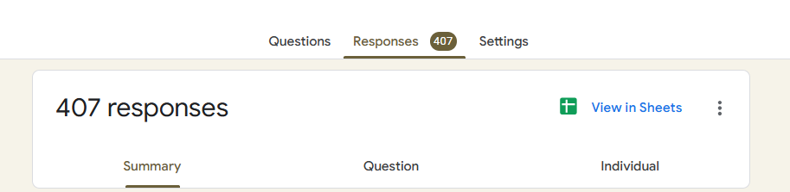
Research Questions and Hypotheses
Methodology
Research Design:
Quantitative survey-based study.
Sample:
385+ students: 407 to be exact.
Data Collection:
Research Question:
Online survey using Google Forms.
What factors influence students' sustainability intentions and behaviors?
Variables:
Independent: Attitudes, perceived control, social norms.
Hypotheses:
Dependent: Behavioral intentions, actual behaviors.
Hypothesis1: Attitudes positively influence sustainability intentions.
Hypothesis2: Perceived control positively influences sustainability behaviors.
Hypothesis3: Social norms positively influence sustainability intentions.

Slide 5
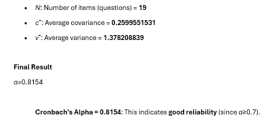
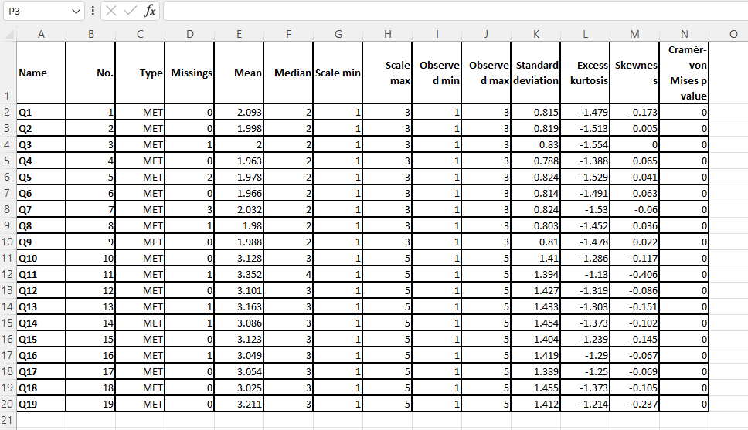
Measurement Model
Constructs and Indicators:
Attitudes: Q1, Q2, Q3.
Perceived Control: Q4, Q5, Q6.
Social Norms: Q7, Q8, Q9.
Mega Construct 1.
Mega Construct 2.
Calculated variance for each Q (column) and covariance for each combination for ensuring internal reliability with Cronbach’s Alpha
Reliability and Validity:
Cronbach’s Alpha: ≥ 0.7.
Composite Reliability (CR): ≥ 0.7.
Average Variance Extracted (AVE): ≥ 0.5.
p value < 0.5
Key Findings:
H1: Supported (p < 0.05). H2: Supported (p < 0.05).

Slide 6
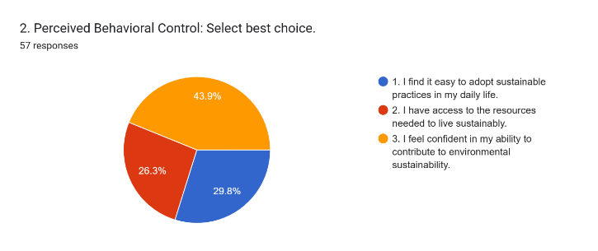
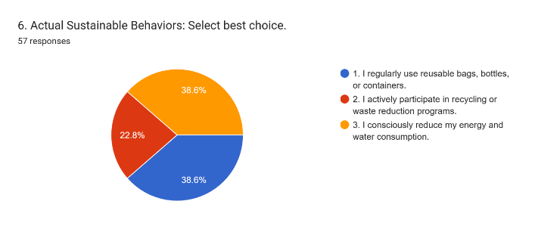
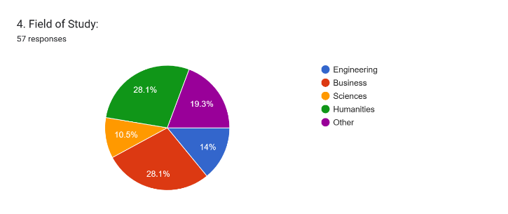
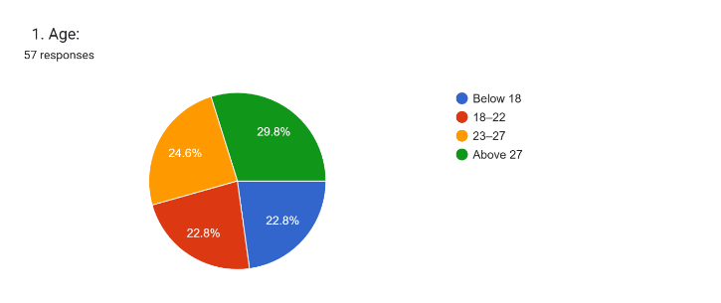
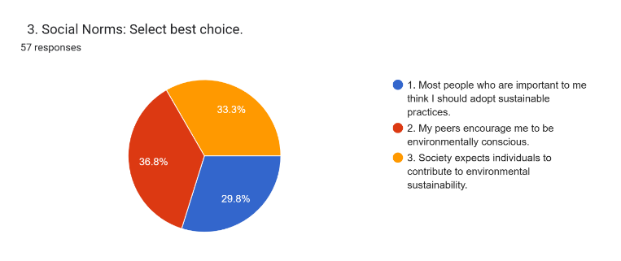
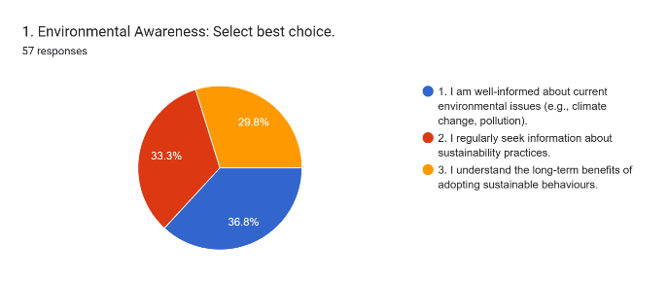
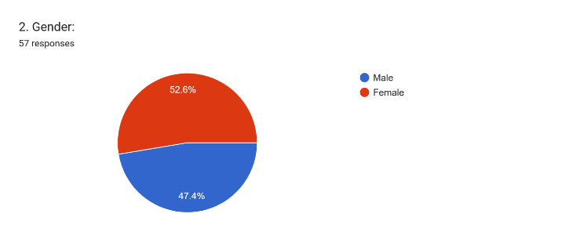

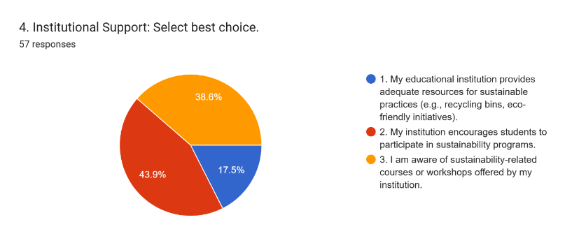
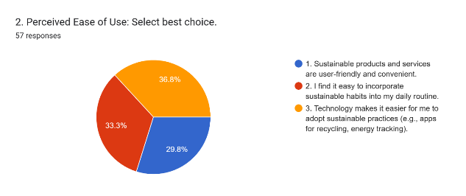
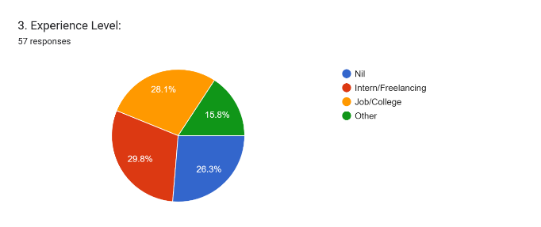
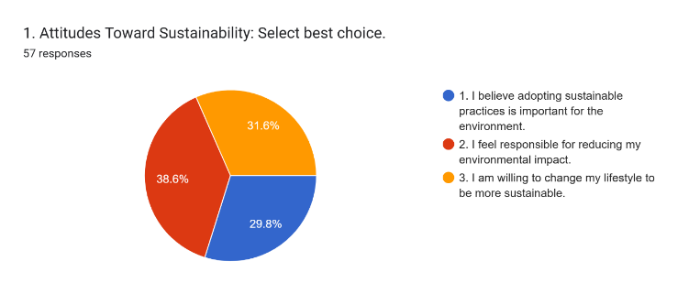
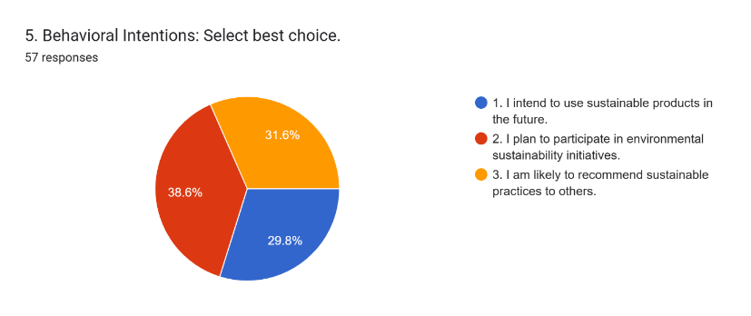
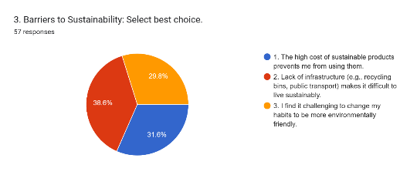
Pilot Test Results/Data Analysis
Visuals:
Key Findings:
All constructs meet reliability and validity thresholds.

Slide 7
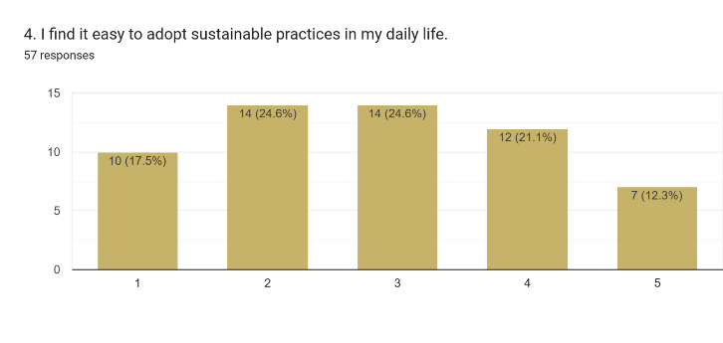
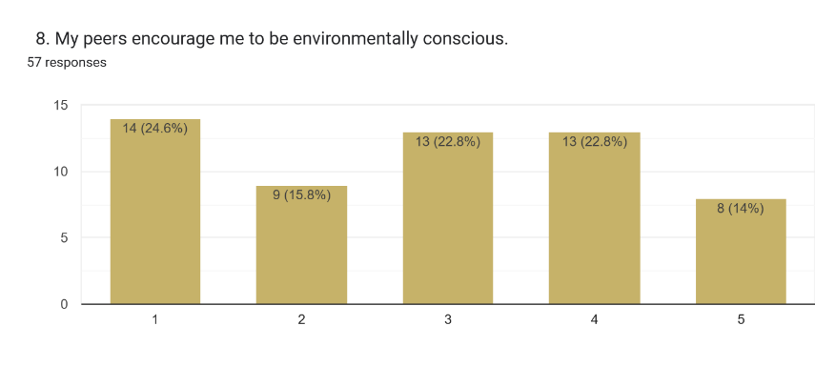
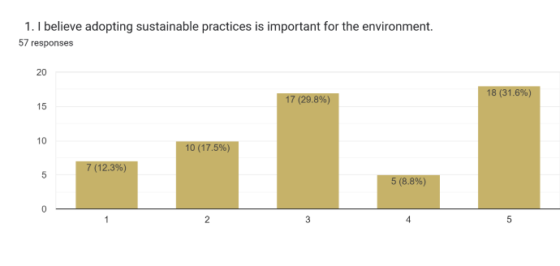
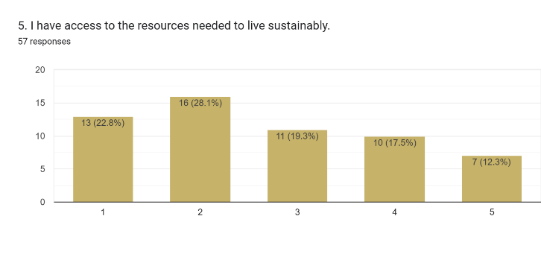
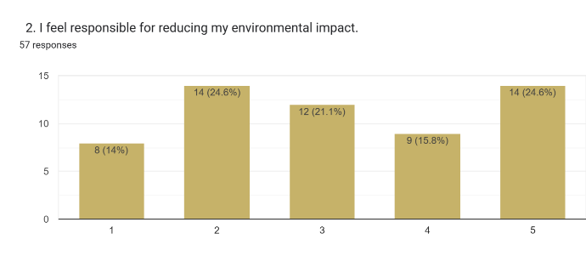
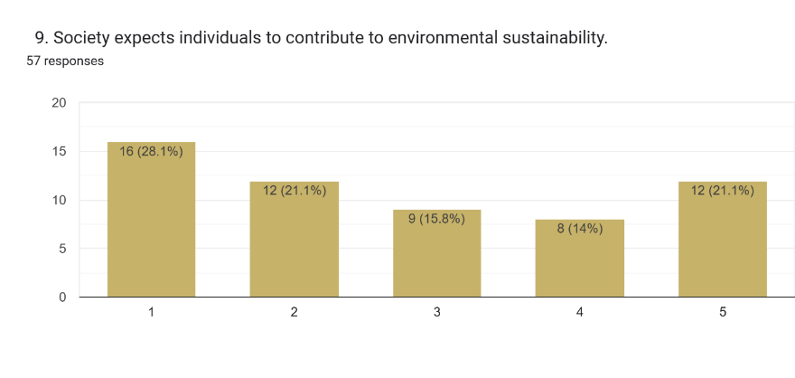
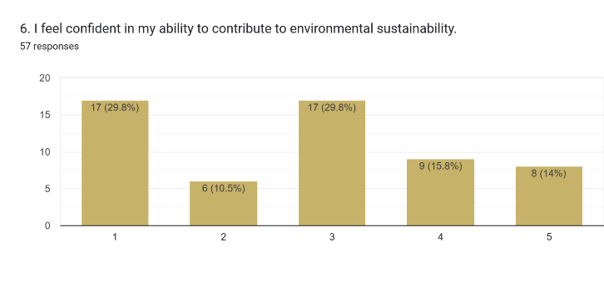
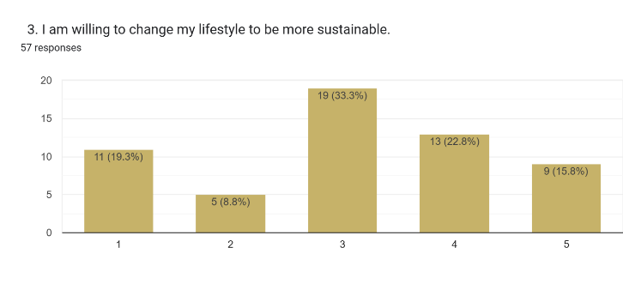
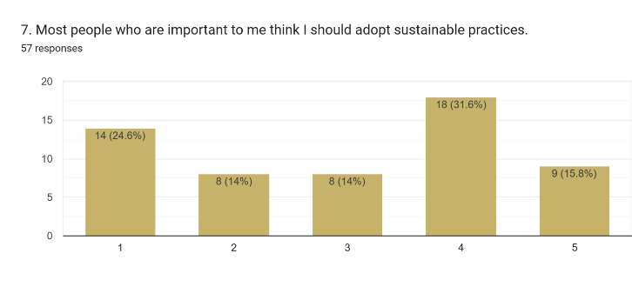
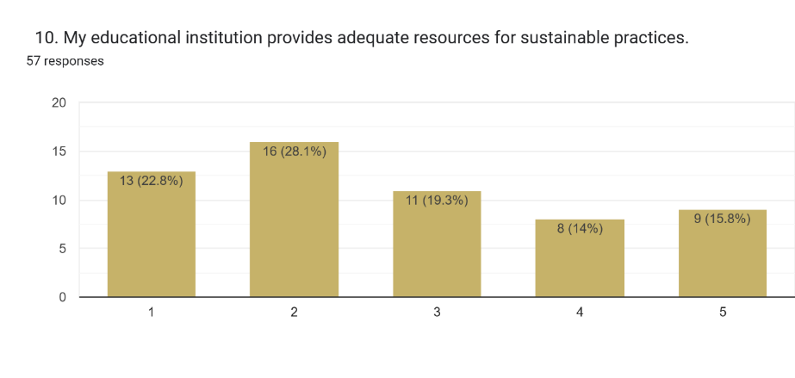
Pilot Test Results
Visuals: Data Analysis
Key Findings:
All constructs meet reliability and validity thresholds.

Slide 8
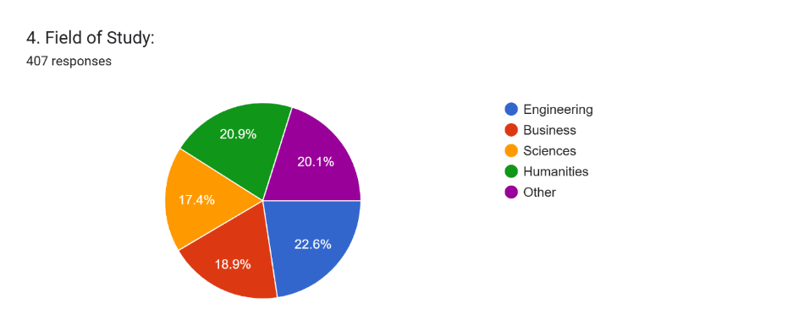
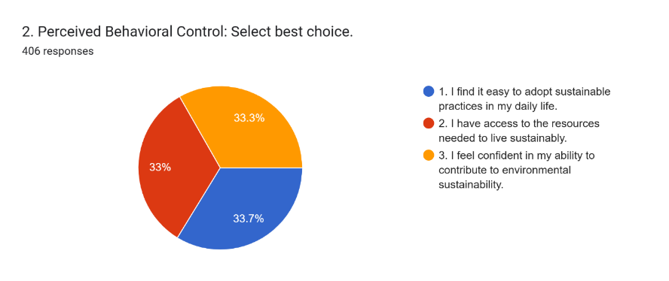
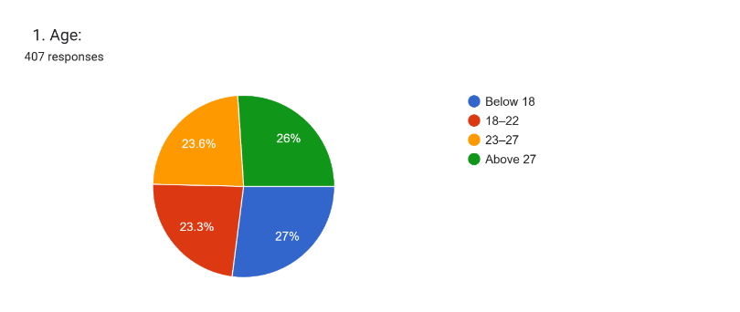
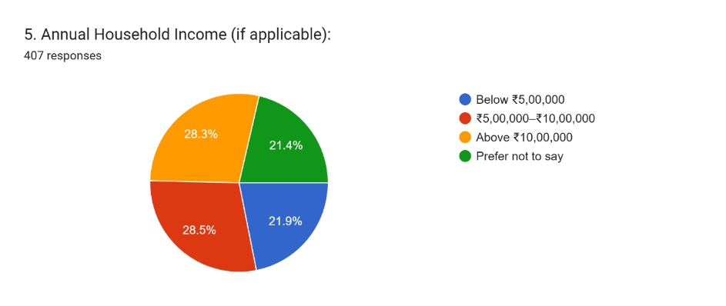
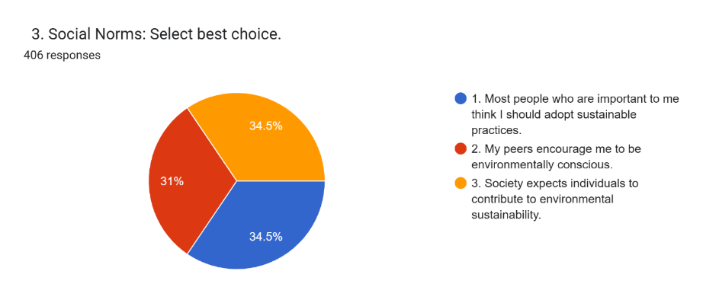
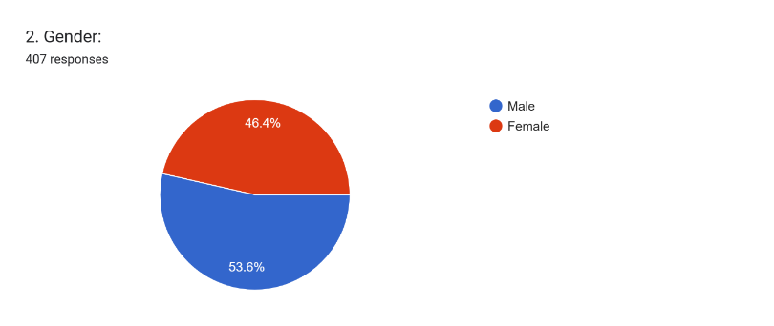
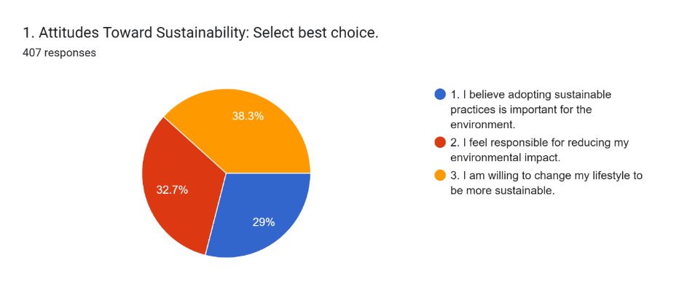
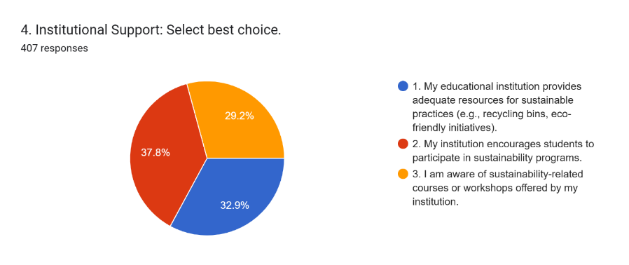
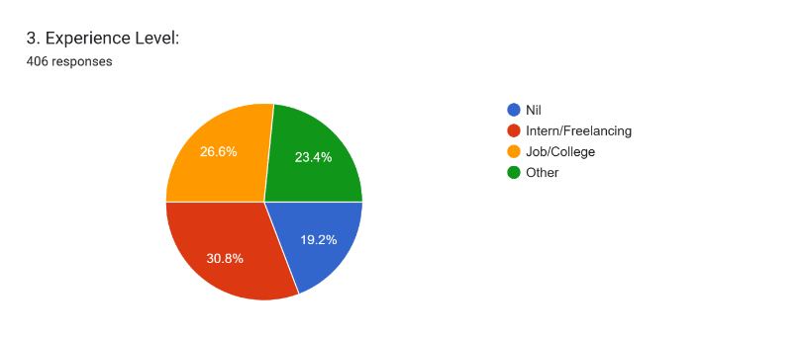
Data Analysis
Infographic: Real Survey

Slide 9
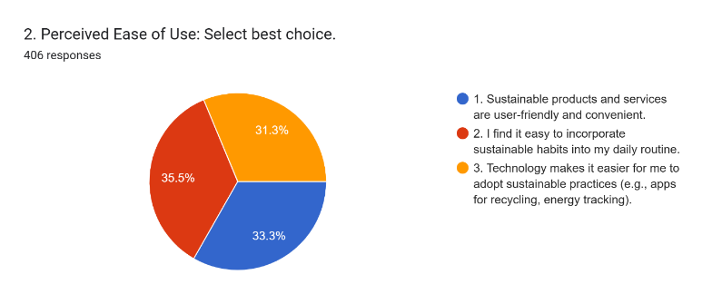
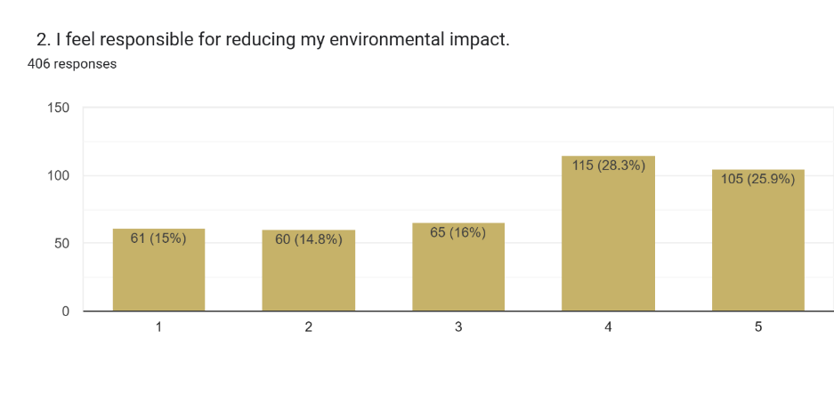


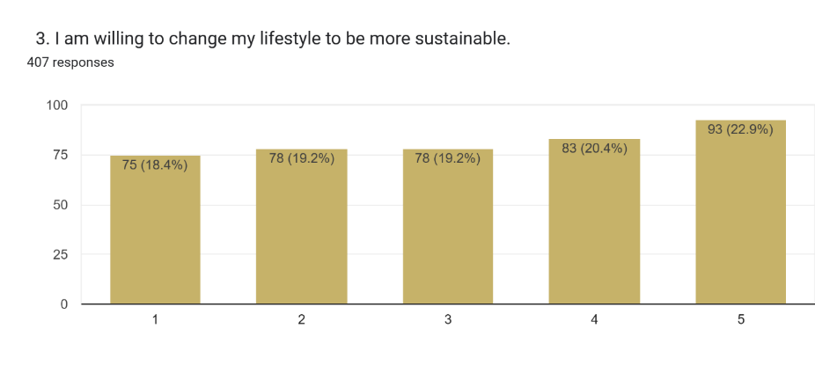

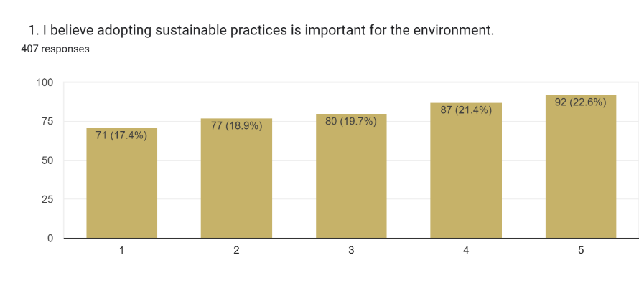
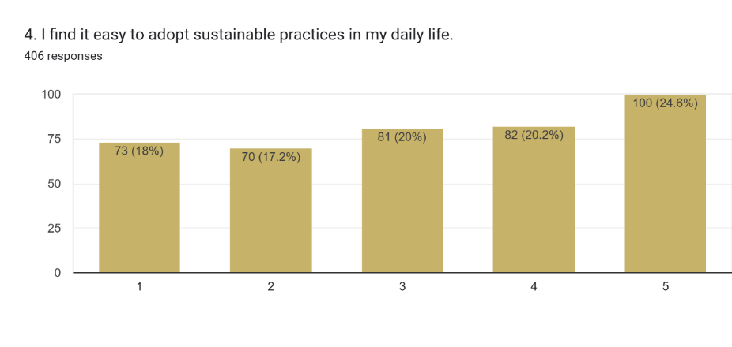

Data Analysis
Infographic:

Slide 10
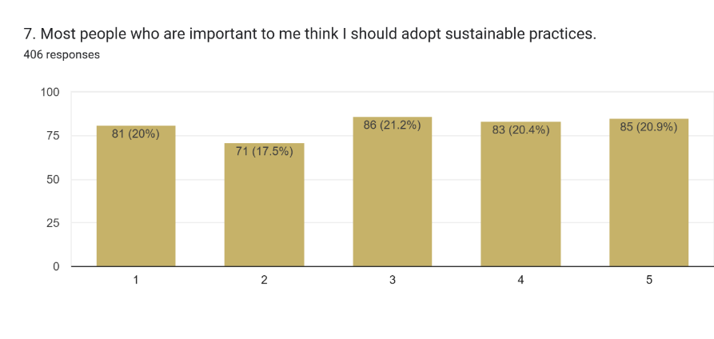
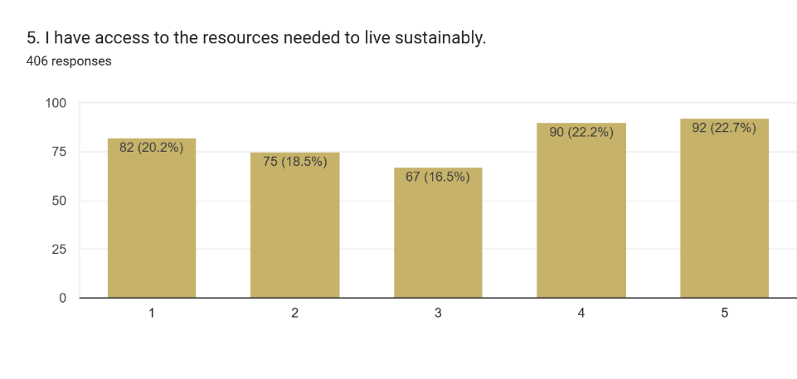
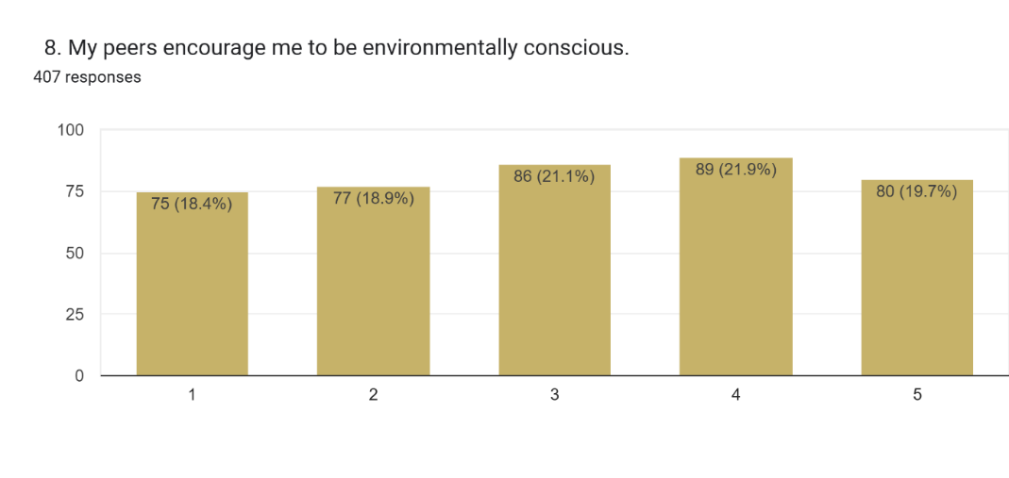
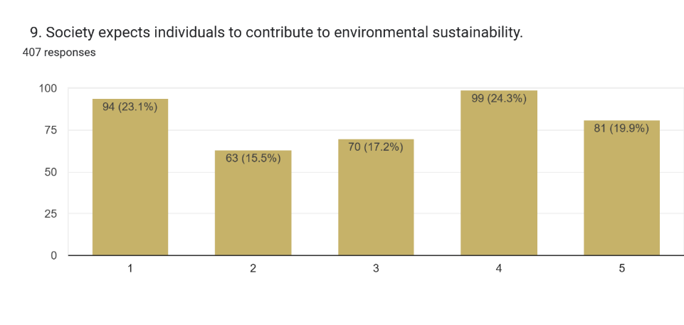
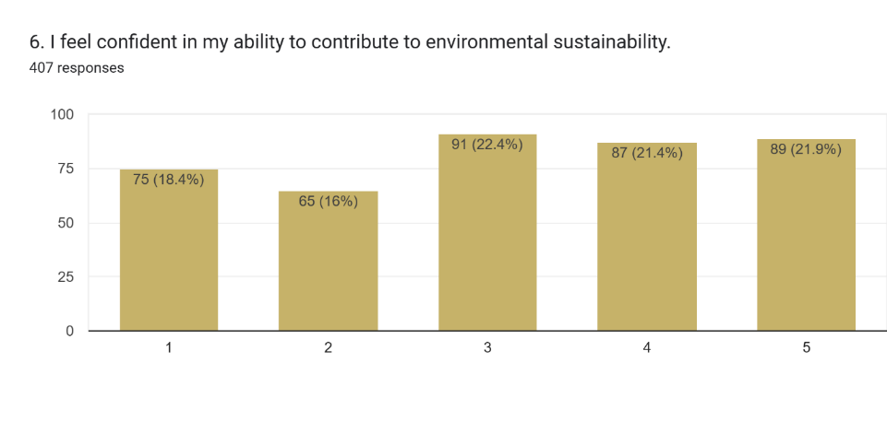
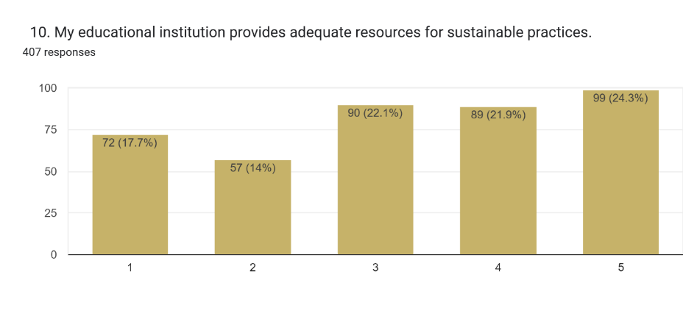
Data Analysis
Infographic:

Slide 11
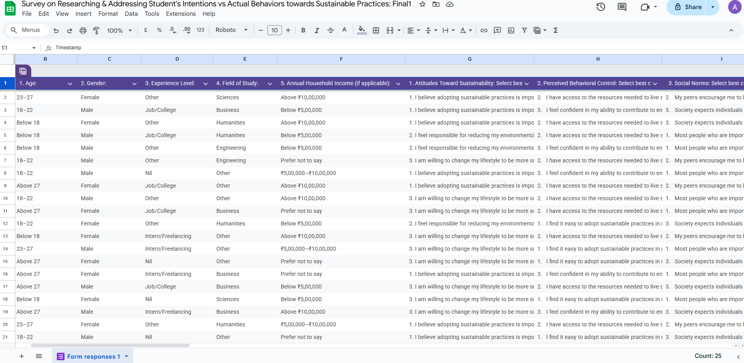
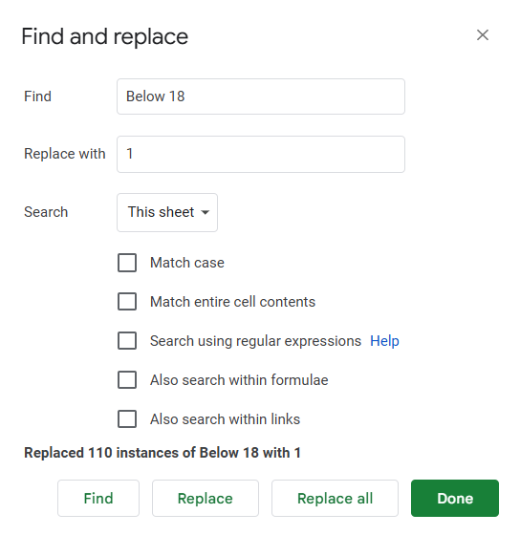
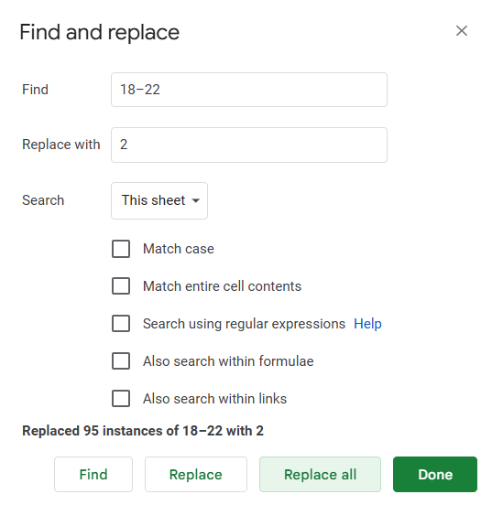
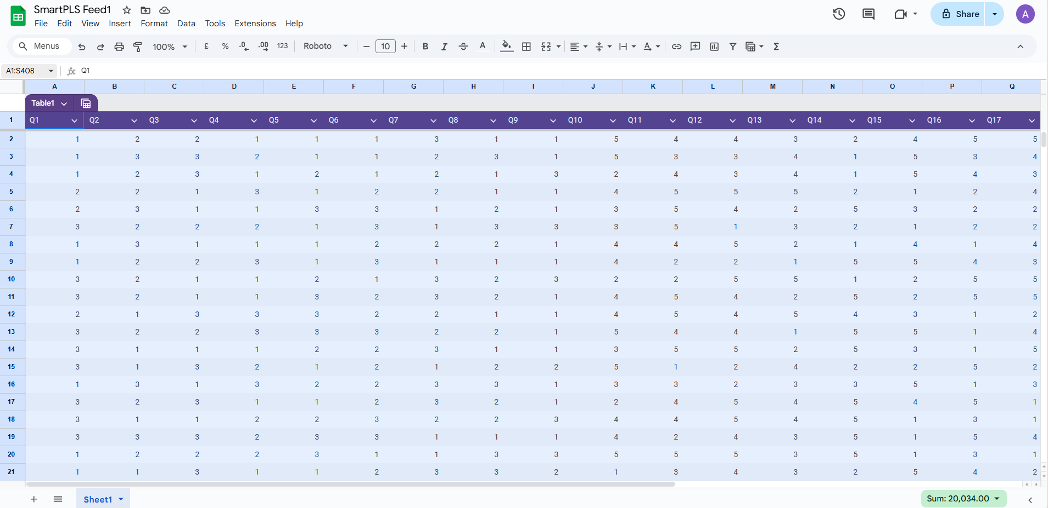


Data Analysis
Infographic:

Slide 12



Data Analysis
Infographic: Software usage: SmartPLS

Slide 13



Q&A

Slide 14



Q&A

Slide 15



Q&A

Slide 16
Limitations
Conclusions & Key Findings
Sample Size:
Attitudes and perceived control are the strongest predictors of sustainability intentions and behaviors.
Social norms do not significantly influence students' sustainability actions.
Behavioral intentions strongly predict actual behaviors.
Demographic factors (like gender, field of study) play a moderating role.
Barriers like cost and lack of infrastructure hinder sustainable practices.
Institutional support enhances students' ability to adopt sustainable behaviors.
The measurement model is reliable and valid ( Alpha=0.8+, CR ≥ 0.7, AVE ≥ 0.5).
Limited to 385+ (407) students.
Geographical Scope:
Focused on a single survey.
Methodology:
Reliance on group-reported data.
Future Recommendations
Expand Dataset:
Include more diverse samples.
Contributions:
Explore Additional Variables:
Advances understanding of sustainability behavior in students.
Provides practical recommendations for policymakers.
Environmental awareness, moral norms.
Longitudinal Studies:
Track behaviour over time.

Slide 17
References
Acknowledgments
Discussion
Comparison with Previous Studies:
We would like to express our sincere gratitude to Rajendra Mishra School of Engineering Entrepreneurship, IIT Kharagpur, for providing us with the opportunity and resources to conduct this research.
Special thanks to our esteemed Professor Dr. Mamoni Banerjee, for her invaluable guidance, insightful feedback, and unwavering support throughout the project. Her expertise and encouragement have been instrumental in shaping this study.
We are also deeply thankful to all our teammates & survey participants who took the time to share their contributions, responses and experiences. Without their cooperation, this research would not have been possible.
Their contributions have provided meaningful insights into the factors influencing student intentions and behaviors toward environmental sustainability.
Finally, we extend our appreciation to our Professor’s Teaching
Assistant Mr. Suraj Sir and peers for their constructive suggestions
and
support during the course of this project.
The positive relationship between attitudes and sustainability intentions aligns with the Theory of Planned Behavior, which emphasizes the role of attitudes in shaping intentions. Also, The significant influence of perceived behavioral control on behavior is consistent with studies by Bamberg & Moser, who found that perceived control is a strong predictor of sustainable actions.
RESULTS & Implications:
Our study focused on attitudes and perceived control for interventions. It also reinforced the importance of attitudes and perceived control in sustainability models while challenging the universal applicability of social norms.
Ajzen, I. (1991). Theory of Planned Behavior.
Bamberg, S., & Möser, G. (2007). Environmental Psychology.
Kollmuss, A., & Agyeman, J. (2002). Sustainability Behavior.

Slide 18

Appendix: Data Analysis
Additional Data:
Full correlation matrix.
Thank You

